Slide 1
TCP/IP Reference Model
Presented by:-
Purushottam Singh
&
Satish Vanjara

Slide 2
TCP/IP
TCP/IP that is transmission control protocol and internet protocol was developed by Defense's Advanced Research Project Agency (ARPA, later DARPA) as a part of a research project of network interconnection to connect remote machines.
Continue….

Slide 3
The features that stood out during the research, which led to making the TCP/IP reference model were :-
Support for a flexible (લવચીક) architecture. Adding more machines to a network was easy.
The network was robust (મજબુત), and connections remained intact (અખંડ) untill the source and destination machines were functioning.
Continue….

Slide 4
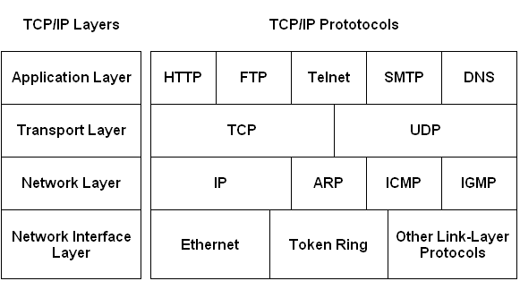
The overall idea was to allow one application on one computer to talk to(send data packets) another application running on different computer.
Continue….

Slide 5
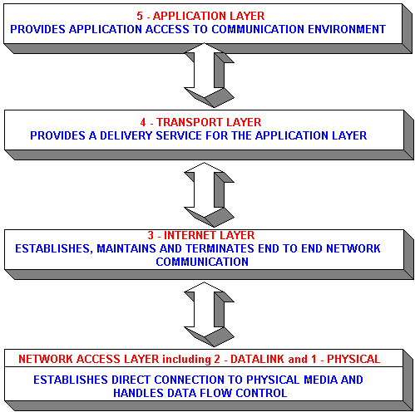
Continue….

Slide 6
Description of different TCP/IP protocols
Layer 1: Network Interface Layer
Lowest layer of the all.
Protocol is used to connect to the host, so that the packets can be sent over it.
Varies (બદલાતું રહે છે) from host to host and network to network.
Continue….

Slide 7
Layer 2: Network Layer
Selection of a packet switching network which is based on a connectionless internetwork layer is called a internet layer.
It is the layer which holds the whole planning together.
It helps the packet to travel independently to the destination.
Order in which packets are received is different from the way they are sent.
IP (internet protocol) is used in this layer.
Continue….

Slide 8
Layer 3: Transport Layer
It decides if data transmission should be on parallel path or single path.
Functions such as multiplexing, segmenting or splitting on the data is done by transport layer.
The applications can read and write to the transport layer.
Continue….

Slide 9
Transport layer adds header information to the data.
Transport layer breaks the message (data) into small units so that they are handled more efficiently (અસરકારક રીતે) by the network layer.
Transport layer also arrange the packets to be sent, in sequence.
Continue….

Slide 10
Layer 4: Application Layer
The TCP/IP specifications described a lot of applications that were at the top of the protocol stack. Some of them were TELNET, FTP, SMTP, DNS etc.
TELNET is a two-way communication protocol which allows connecting to a remote machine and run applications on it.
FTP(File Transfer Protocol) is a protocol, that allows File transfer amongst computer users connected over a
network. It is reliable (વિશ્વસનીય), simple and efficient.
Continue….

Slide 11
SMTP(Simple Mail Transport Protocol) is a protocol, which is used to transport electronic mail between a source and destination, directed via a route.
DNS(Domain Name Server) resolves an IP address into a textual address for Hosts connected over a network.
Continue….

Slide 12

Information is Power
Thank You

